Slide 1
How to not plagiarize

Slide 2
References go at the end of the essay
References: ← use this section heading
Name or Organization (year) Title of article. Retrieved from http://url-goes-here...
WebMD (n.d.) Symptoms of Depression. Retrieved from http://webmd.com/blahblah
Warren, A. (2018) How to not plagiarize. Retrieved from http://misterwarren.weebly.com

Slide 3
If there’s no name/organization
“Title of article.” (year) Retrieved from http://url-goes-here...
“Ketamine Facts” (n.d.) Retrieved from http://ketamine.com
“Effects of PCP” (2018). Retrieved from http://drugs.com/pcp-blah

Slide 4
In-text citations are used at the end of each sentence where you start using a new source of information.
(Name or Organization, year)
(WebMD, n.d.)
(Warren, A., 2018)
(“Title of article”, date) ← only if there’s no name/organization
(“Ketamine Facts”, n.d.)
(“Effects of PCP”, 2018)

Slide 5
How to use in-text citations
Add it to the end of a sentence (Warren, A., 2016).
If there is no date, use n.d. (Warren, A., n.d.).
If there is no author, use the article title in quotation marks (“How to use in-text citations”, 2016).
According to Mr. Warren, you can refer to the source and leave it out of the in-text citation (2016).

Slide 6
How to NOT plagiarize
Copied text must have quotation marks and in-text citations.
note: only use quotes if it matters how the person said it. Don’t use quotes because you’re lazy.
Summarized text must still have in-text citations.
Common knowledge and your opinions do not need in-text citations.

Slide 7
New notes title = “Alcohol”
Name/Organization: TurningPointTraining
Title: Under Construction: Alcohol and the Teenage Brain
Date: 2013, Mar 7
URL: https://www.youtube.com/watch?v=g2gVzVIBc_g
Summary:
After watching the video, explain why abusing drugs would be more harmful for children than adults (younger than mid-20’s). Include in-text citation.
References:
Write what would go in the references section for this video

Slide 8
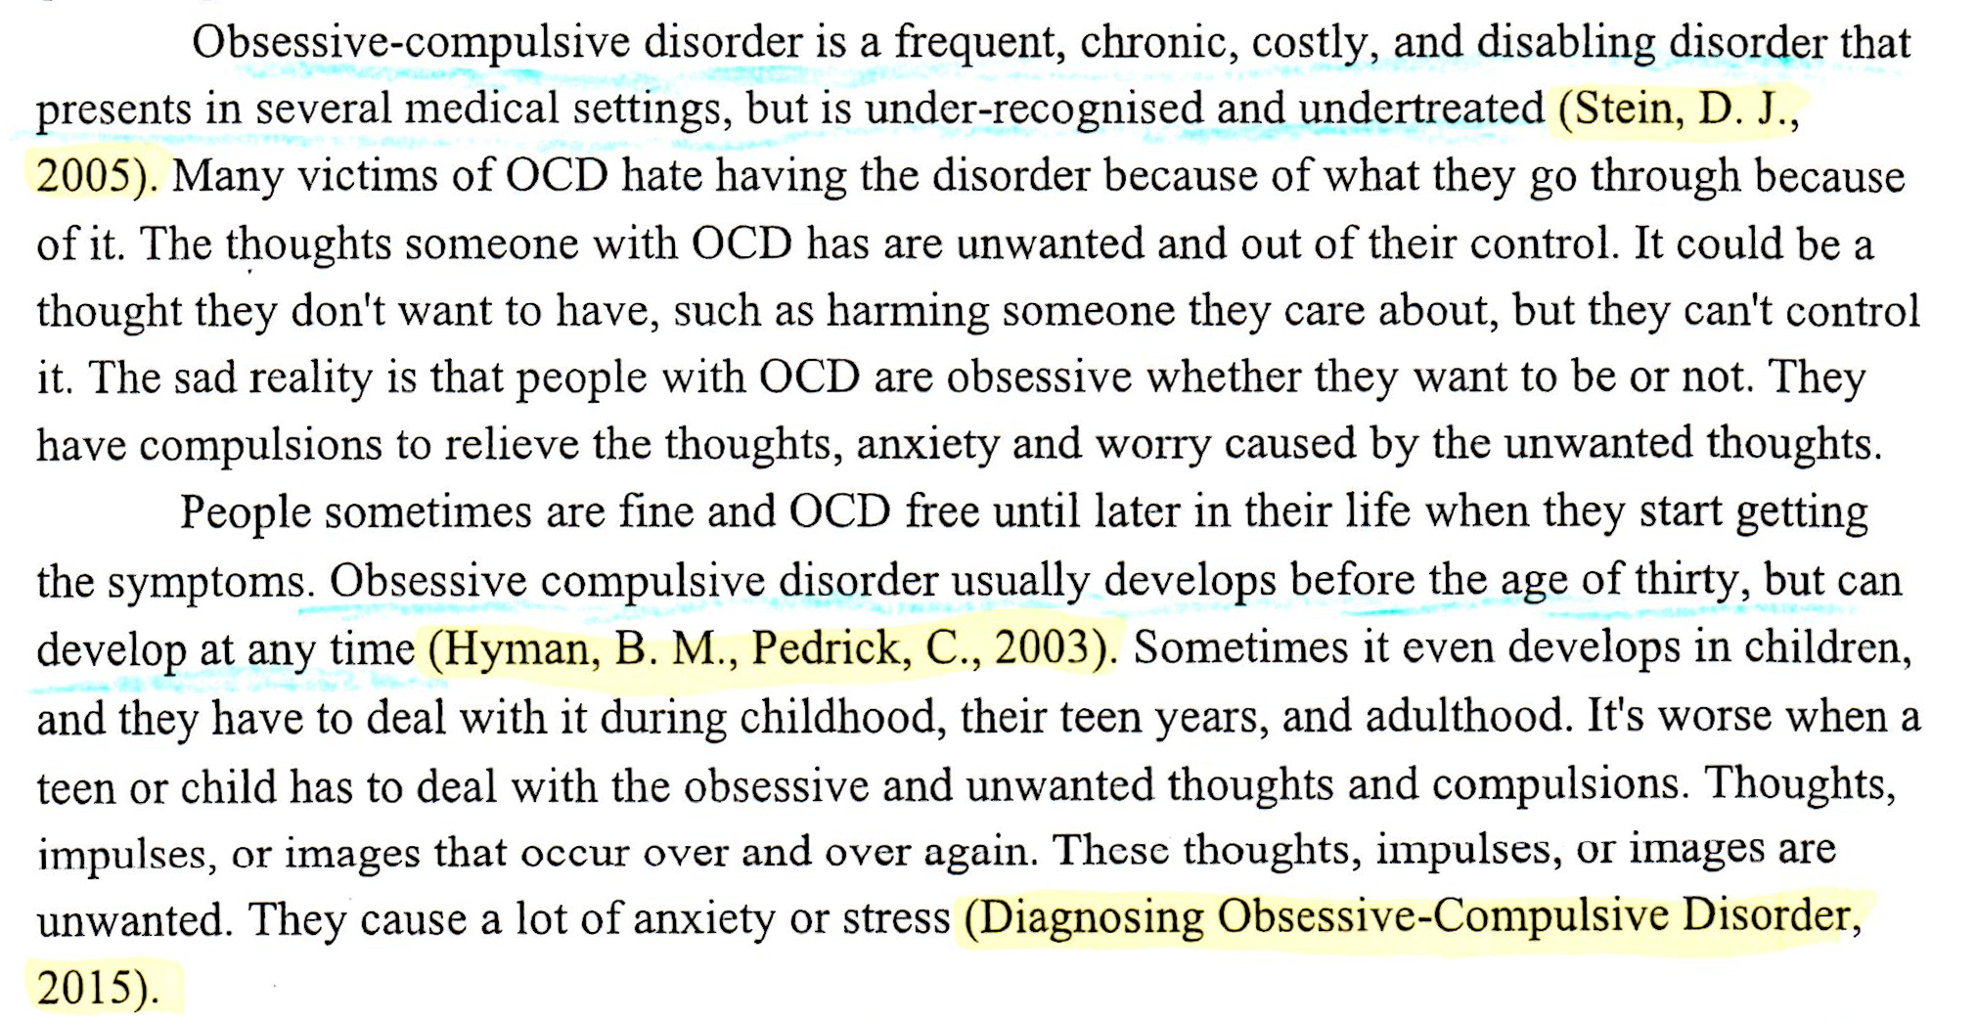
Using in-text citations

Slide 9
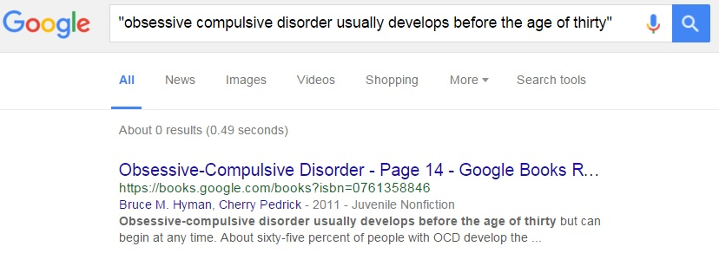
Please do not copy/paste!

Slide 10
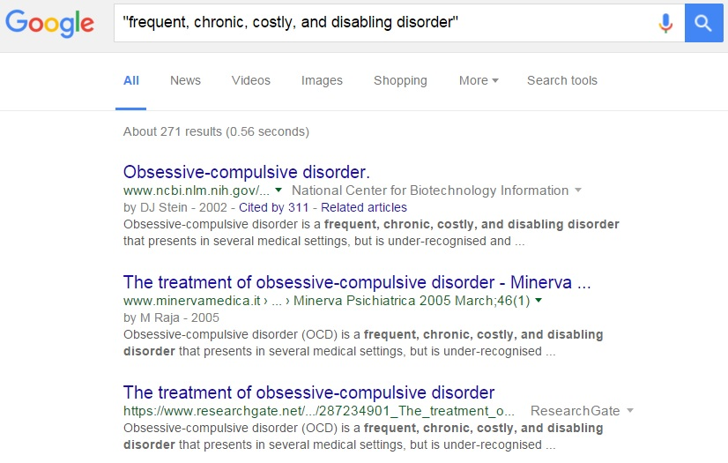
Please do not copy/paste!

Slide 11
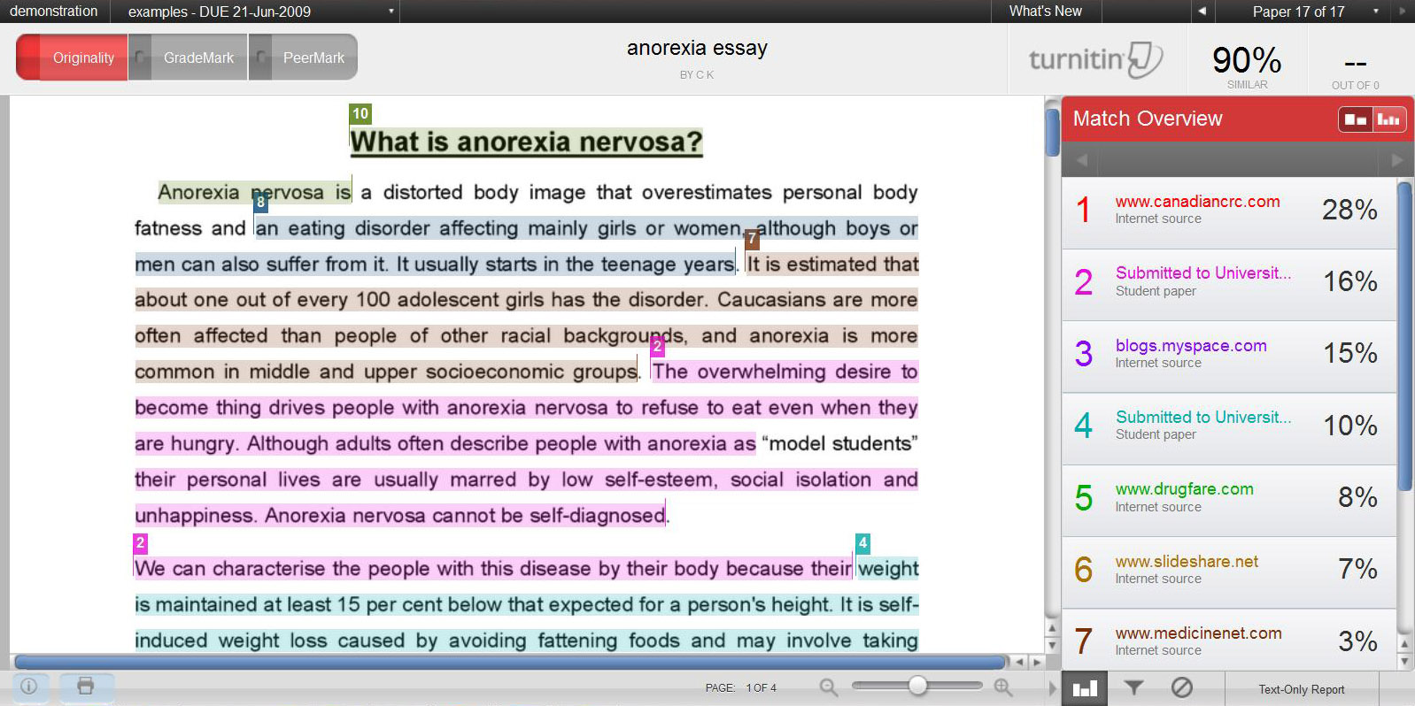
Turnitin

Slide 12
Find sources that cover all of the required information for B-1 (minimum 3). Save the full URL addresses
https://www.google.com/search?q=major+depressive+disorder&rlz=1C1SNNT_enUS543US543&oq=major+depressive+disorder&aqs=chrome..69i57.2324j0j8&sourceid=chrome&ie=UTF-8
Bad: Search results, not a webpage
https://en.wikipedia.org/wiki/Major_depressive_disorder
Bad: wikipedia is not an acceptable source
http://Mayoclinic.org
Bad: the homepage is not the source of your information
https://www.mayoclinic.org/diseases-conditions/depression/symptoms-causes/syc-20356007
Good: Bookmark it or copy/paste it into a google doc

Slide 13
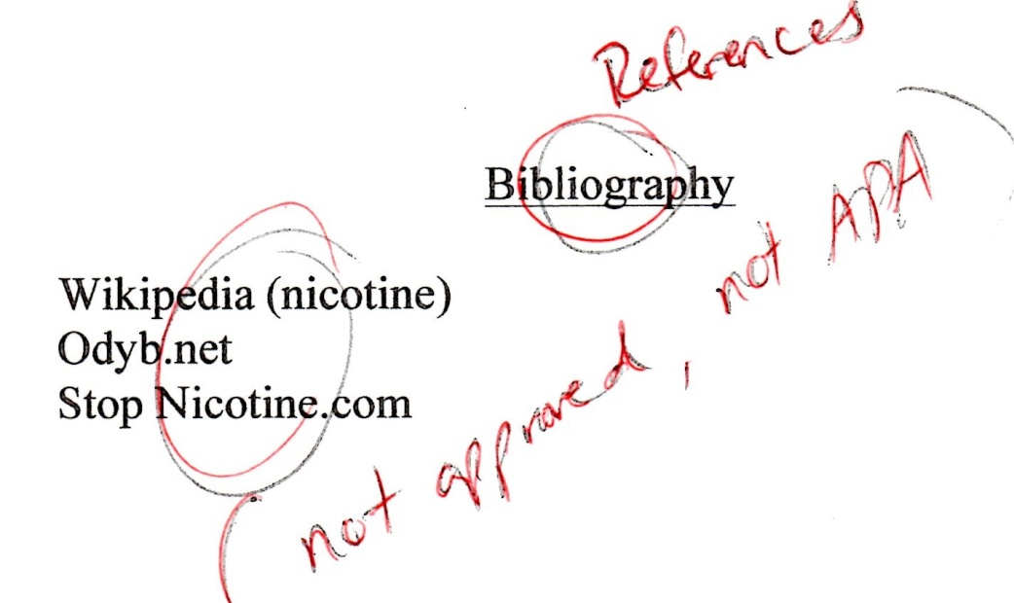

Slide 14
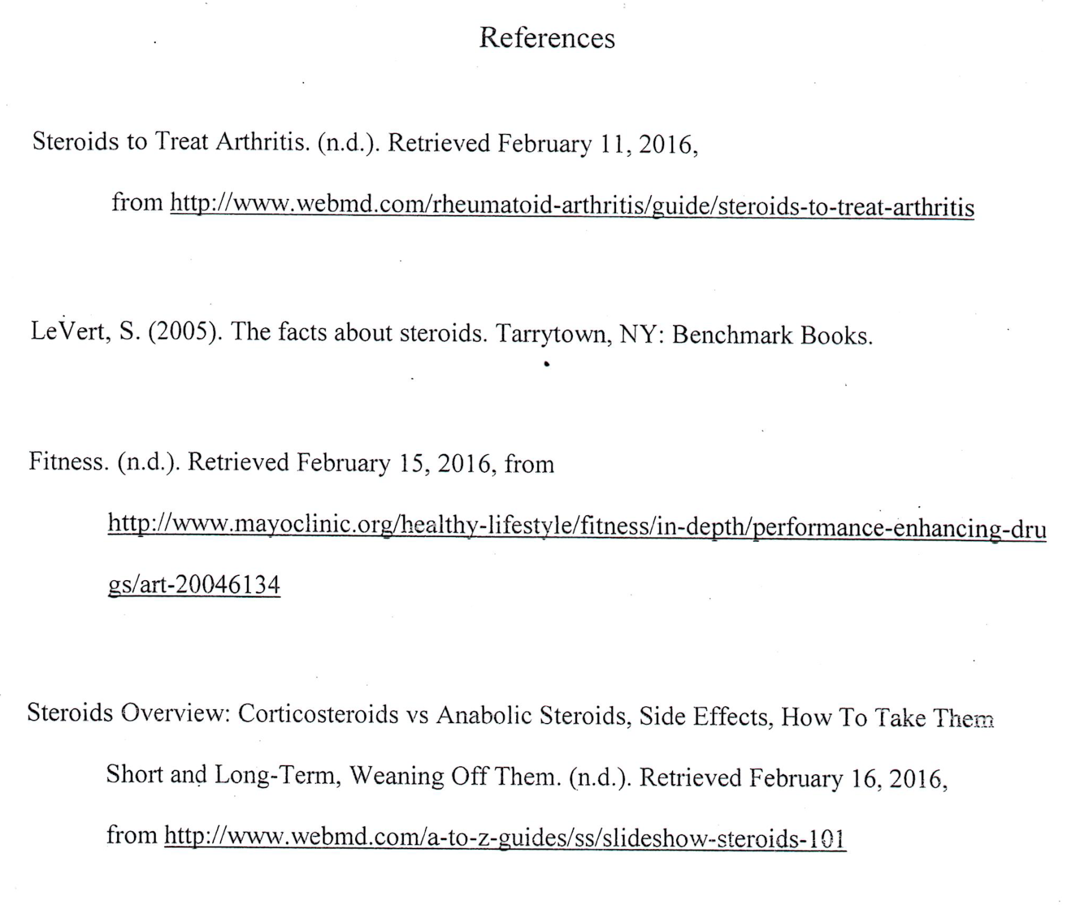
Remember: List in alphabetical order!

Slide 15
Use http://citationmachine.net
Click [Select] and then [Final Step]
If the website had a title, author, or date that was not automatically filled in, enter them manually
Click [Create Citation]
Copy/paste the citations into your word document
Remember to re-arrange them into alphabetical order!

Slide 16
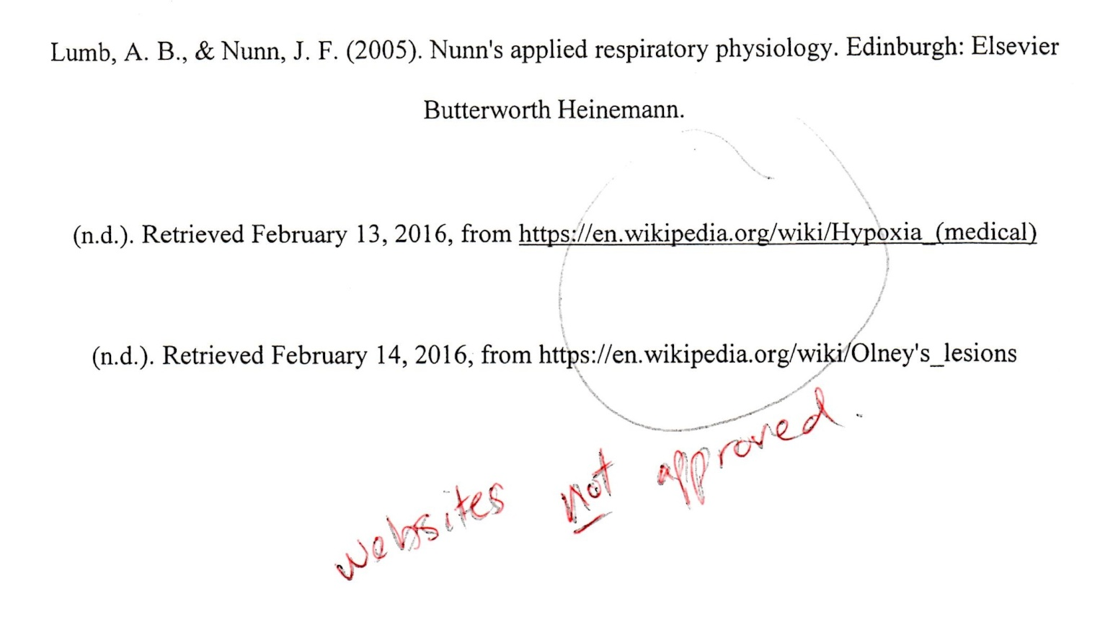
If citation machine doesn’t automatically find the author, date, or title, you must add them manually.

Slide 17
If website, italicize title
If book, italicize book title

