Slide 1
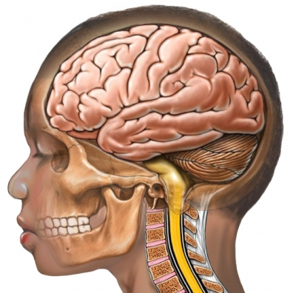
Neuroscience
Notes:
Brainstorm brain functions
Brain/spinal cord
Skull/spinal column

Slide 2
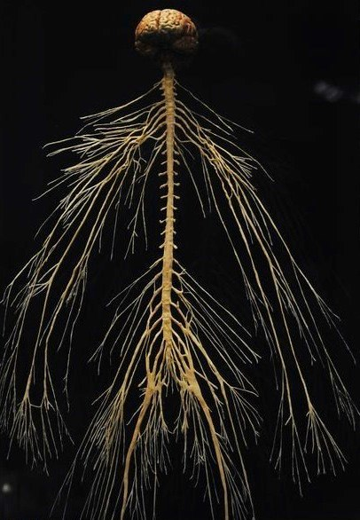
Notes:
Nervous System

Slide 3
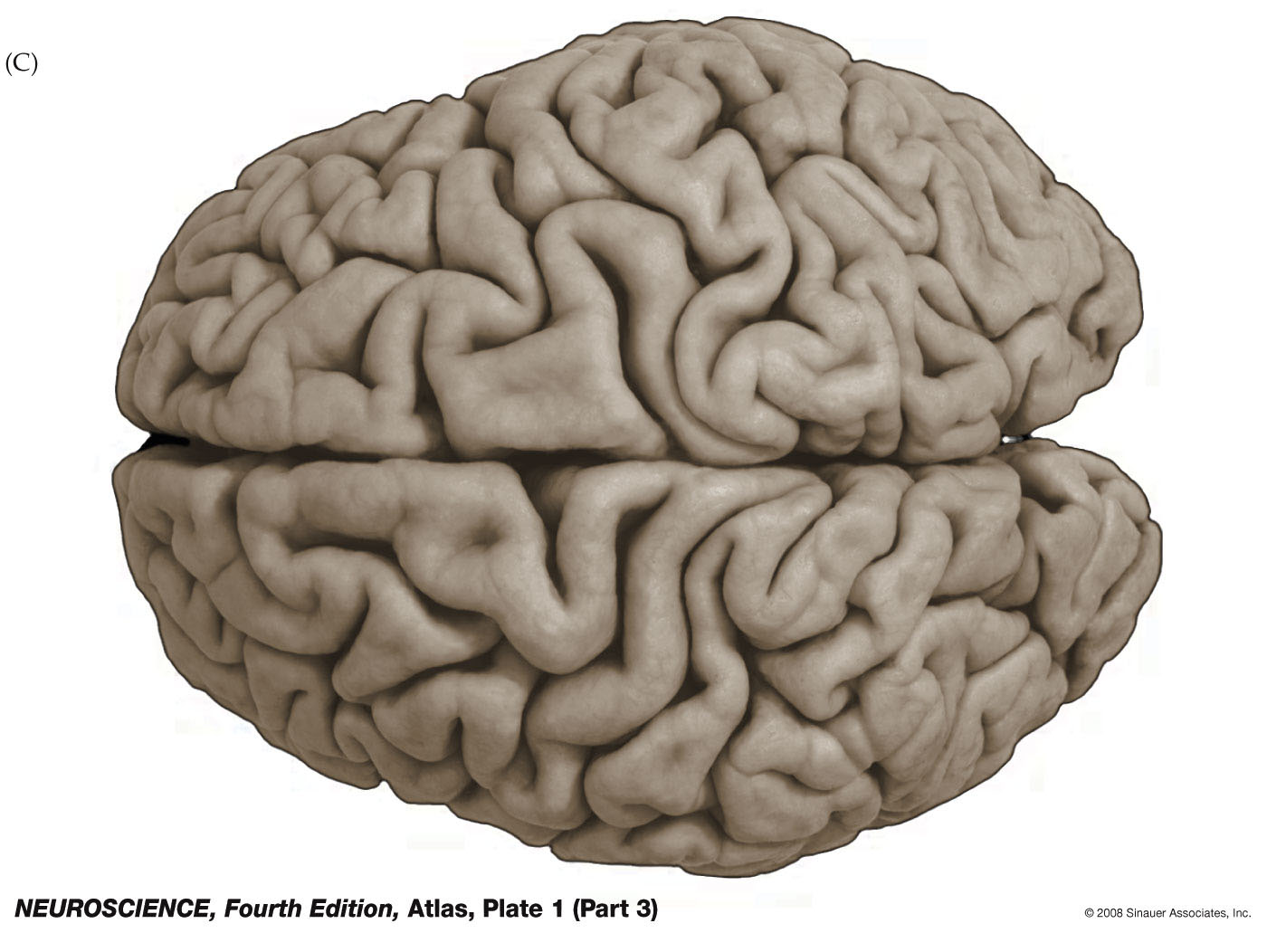
Notes:
Observations: hemispheres, wrinkles

Slide 4
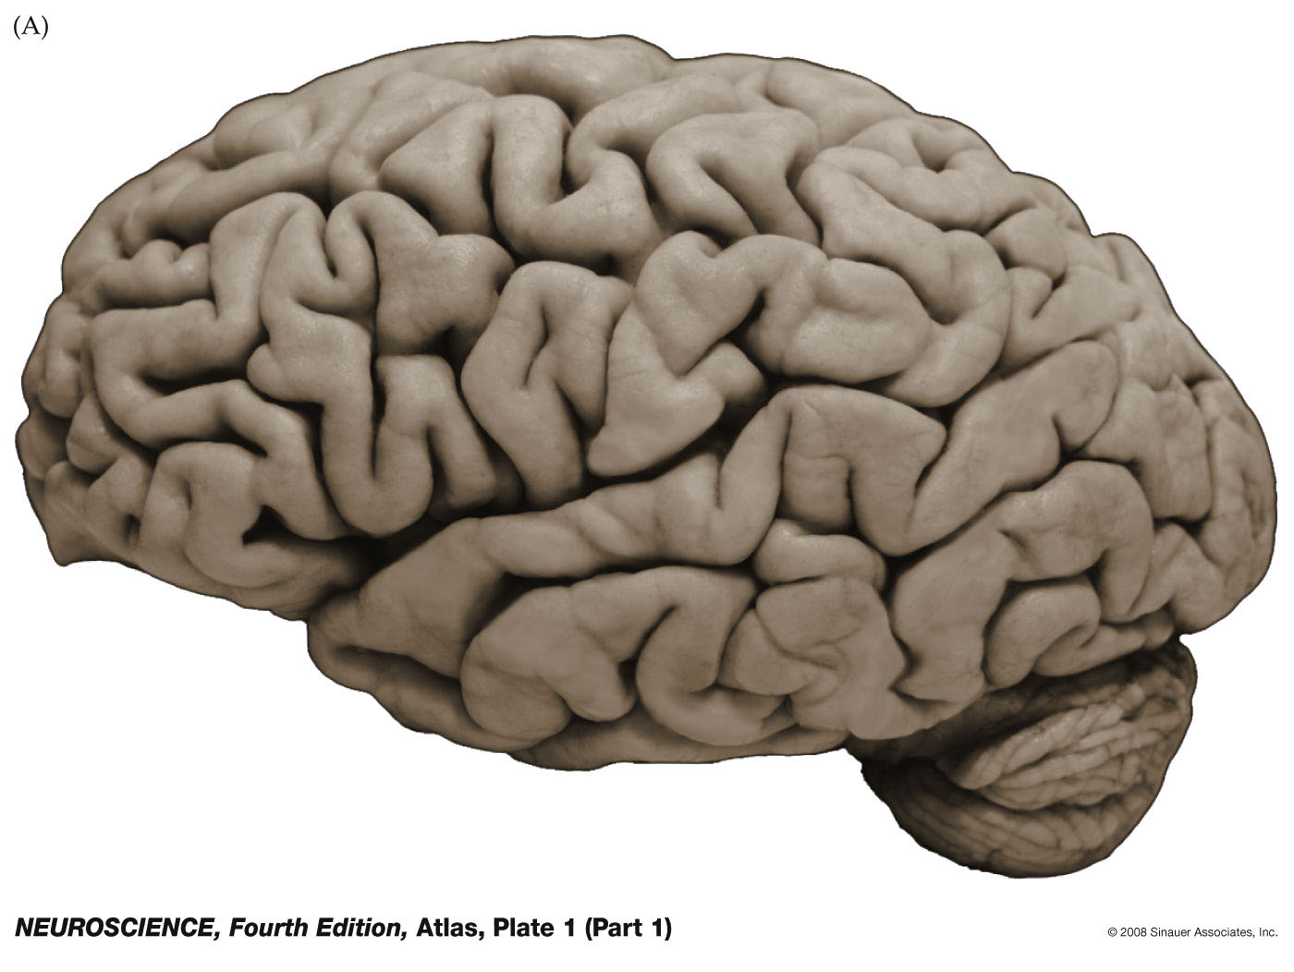
Notes:
Observations: cerebellum

Slide 5
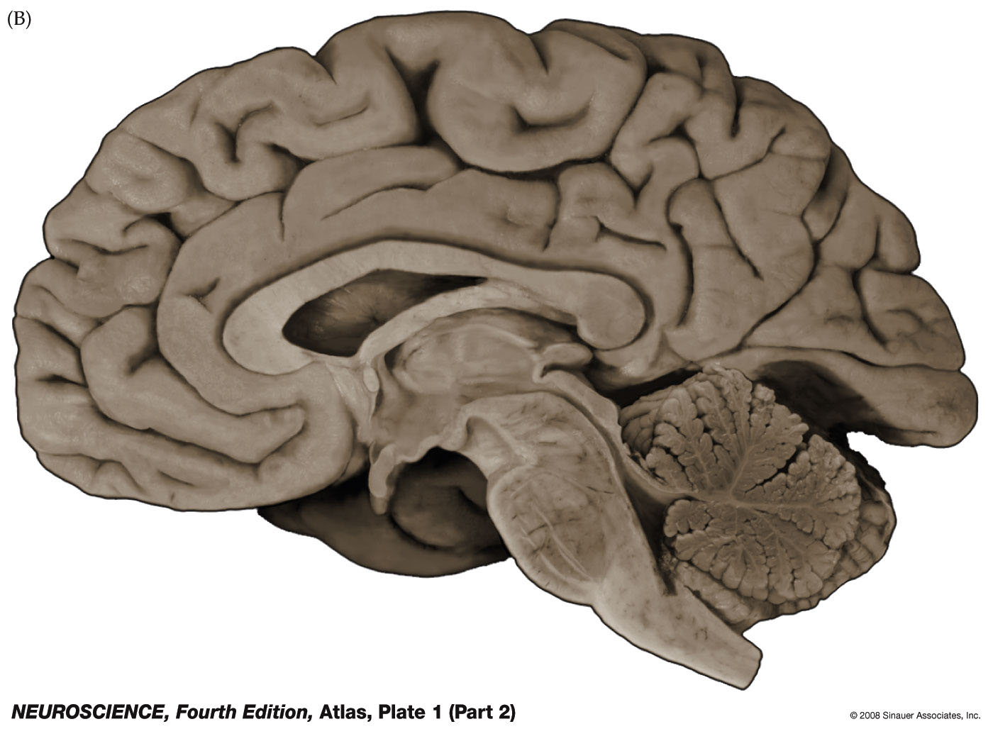
Notes:
Observations: midbrain/brainstem, ventricles, cerebellum

Slide 6
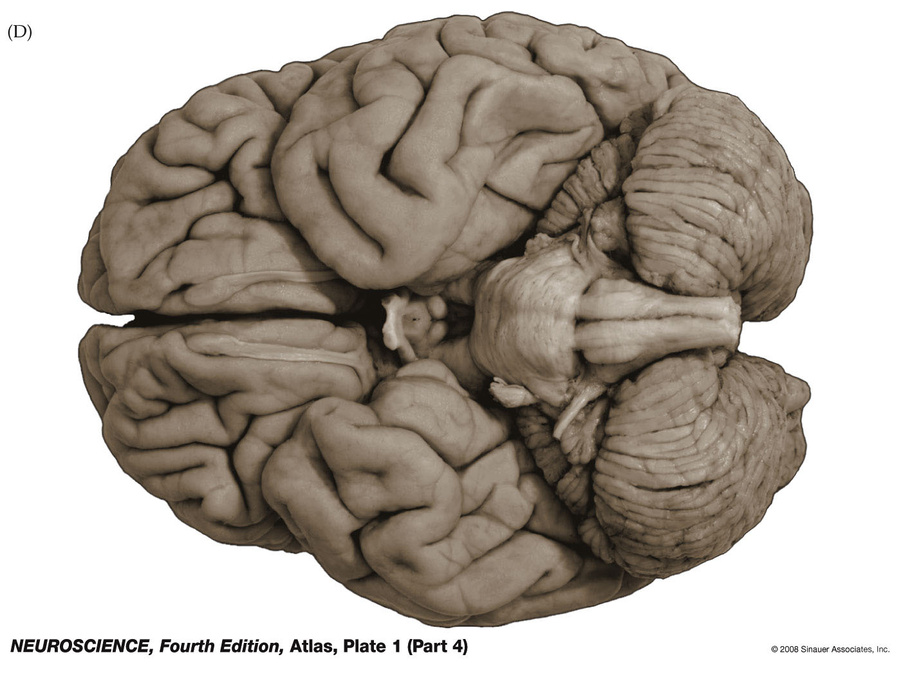
Notes:
Observations:

Slide 7
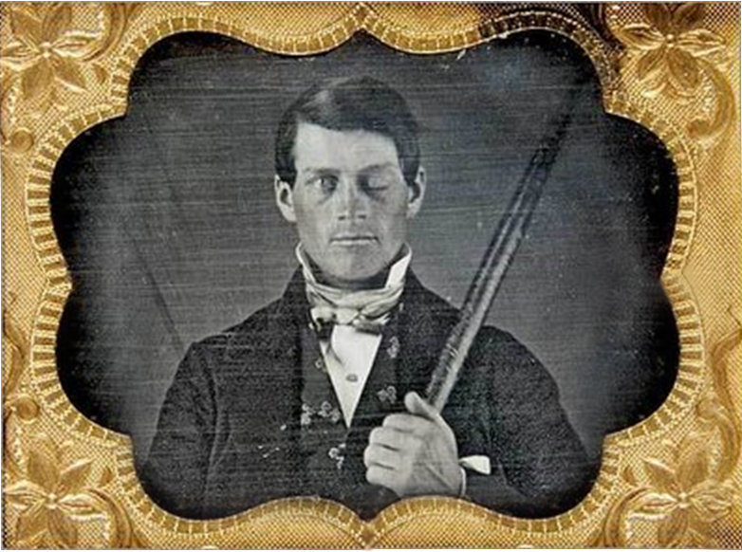
Phineas Gage (1823-1860)
Notes:
-Phineas gage, mid 1800’s railroad worker
-Blasting powder, fuse, sand, tamping iron -> 80 ft away
-2 month recovery
-Disinhibition: Swearing, impatient, short tempered, no attention to consequences

Slide 8
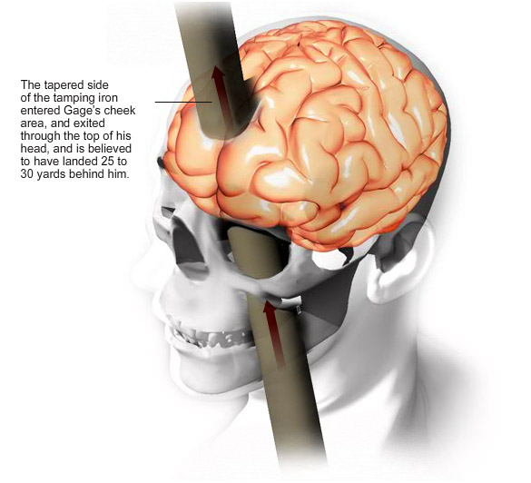
Notes:
Mapping brain functions via brain damage (stroke, war, etc.)

Slide 9
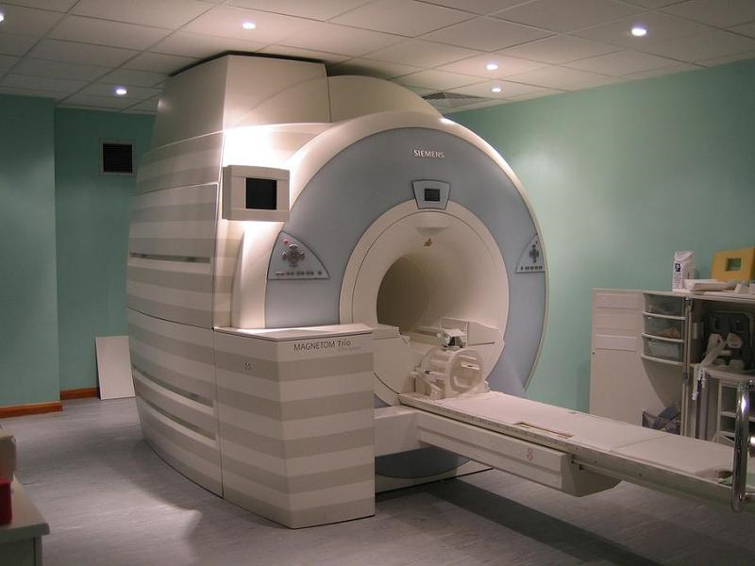
Notes:
MRI, fMRI

Slide 10
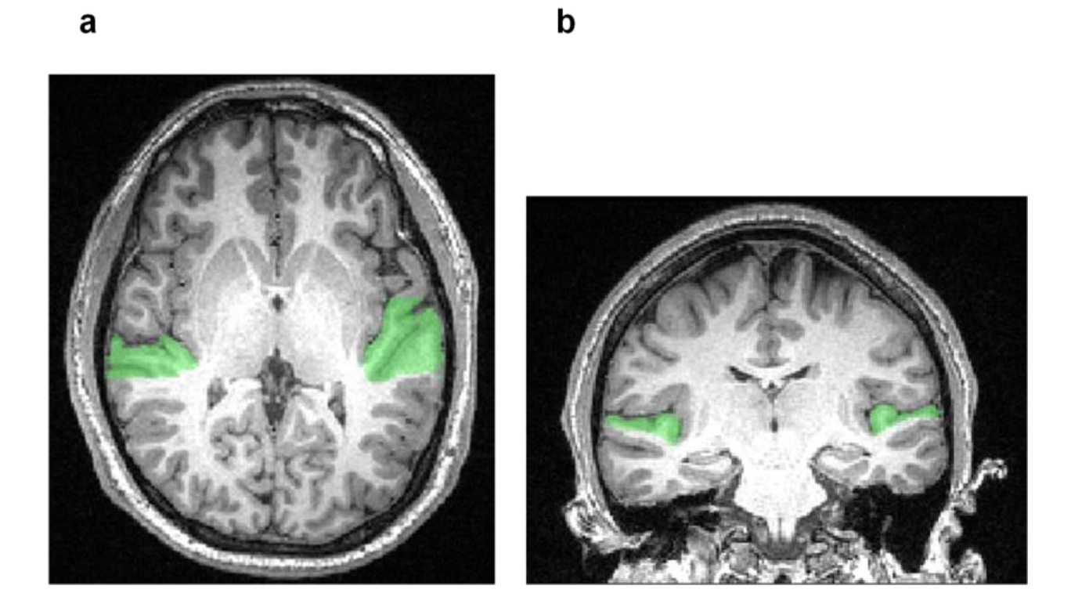
Notes:
Warren’s MRI (fMRI overlay shows hearing in green)

Slide 11
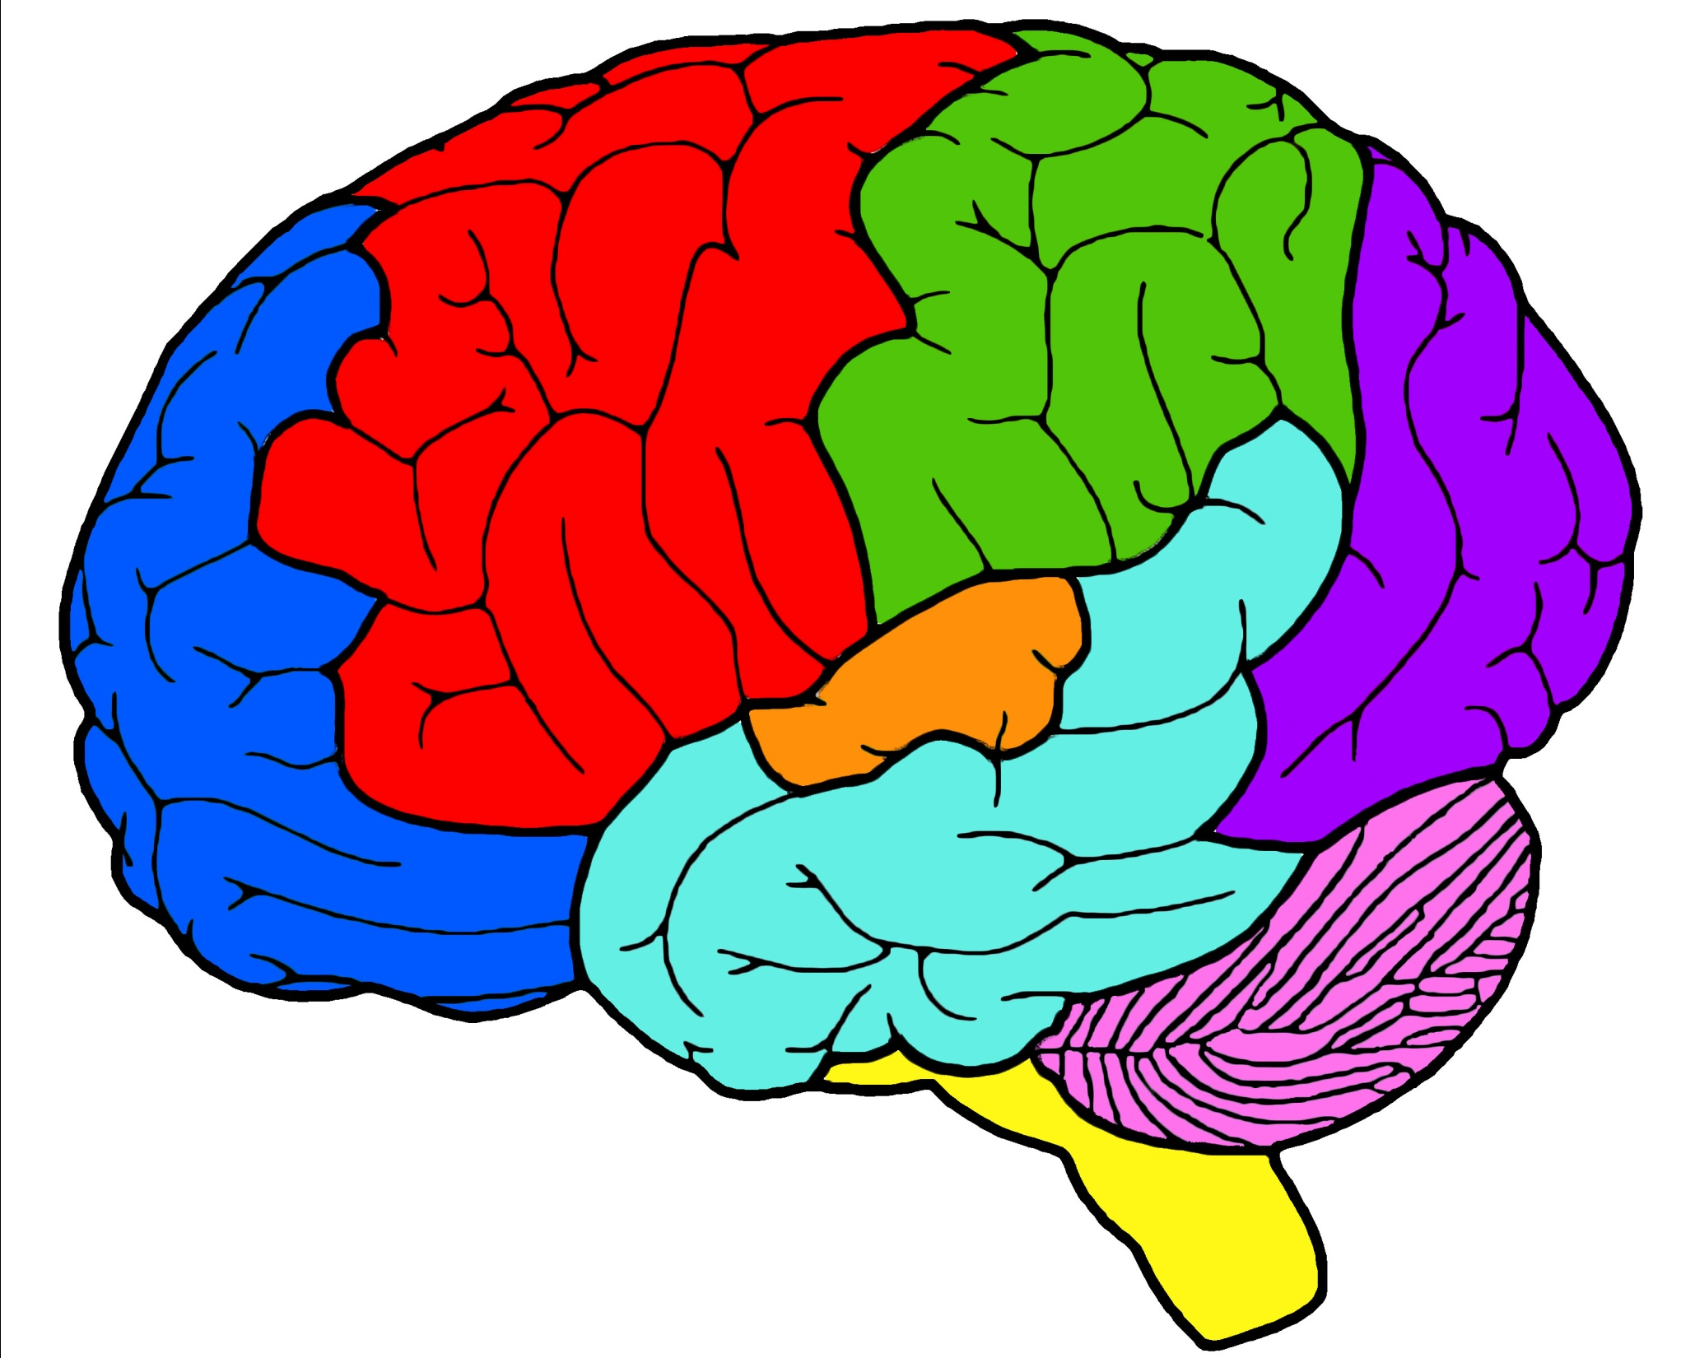
Notes:
Functional regions

Slide 12
Notes:
Functional regions

Slide 13
Notes:
Nerves

Slide 14
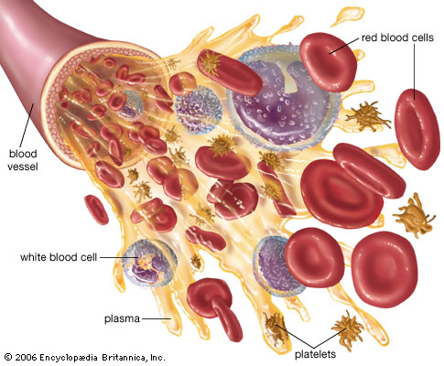
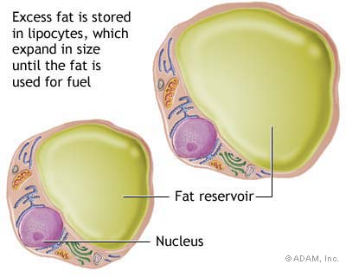
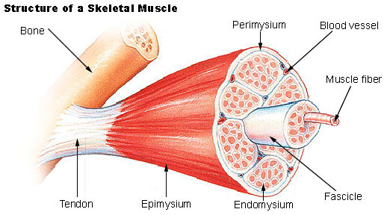
Fat Cells
Blood Cells
Muscle Cells
Notes:
Cell type examples

Slide 15
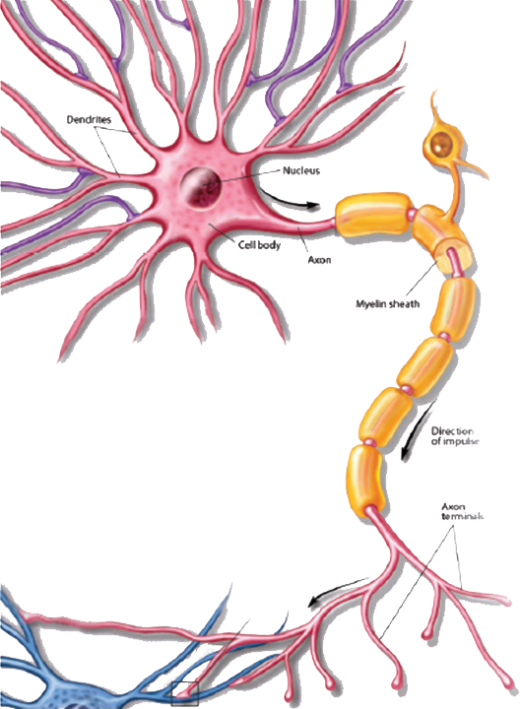
Neuron
(Brain Cell)
There are 100 billion neurons in the brain!
Notes:
neuron

Slide 16
Dendrite
Myelin
Axon terminal
Soma (cell body)
Axon
Notes:
Parts of a neuron

Slide 17
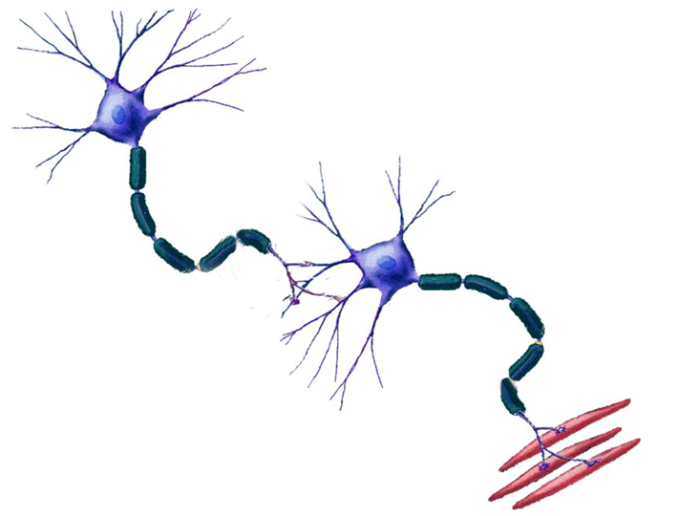
Notes:
Cell-cell communication

Slide 18
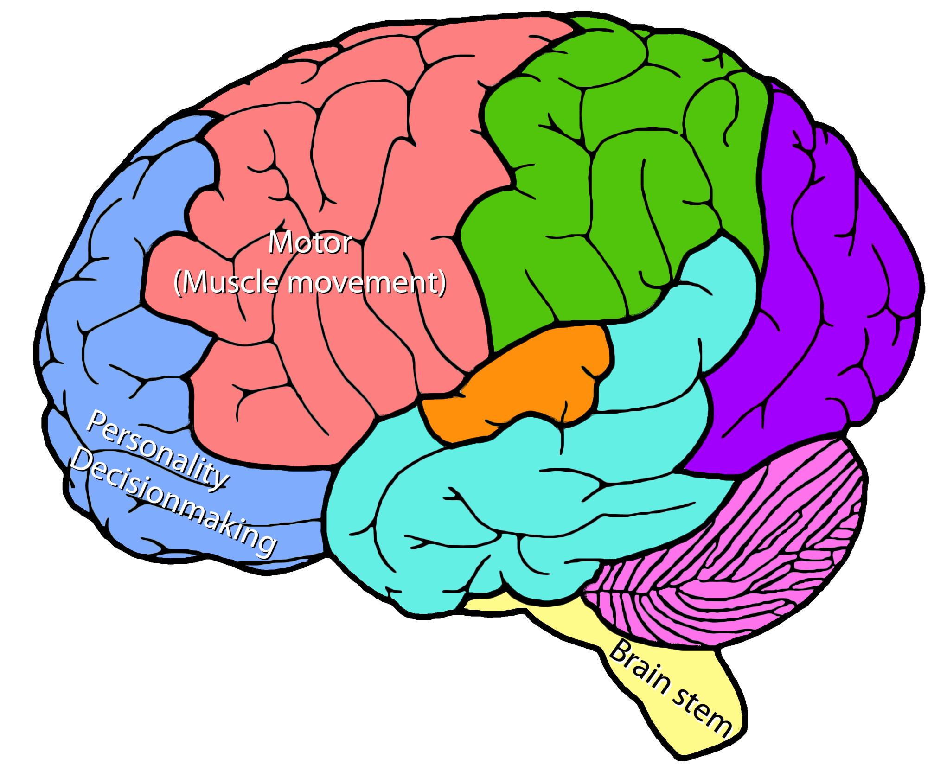
Notes:
Example signal pathway

Slide 19
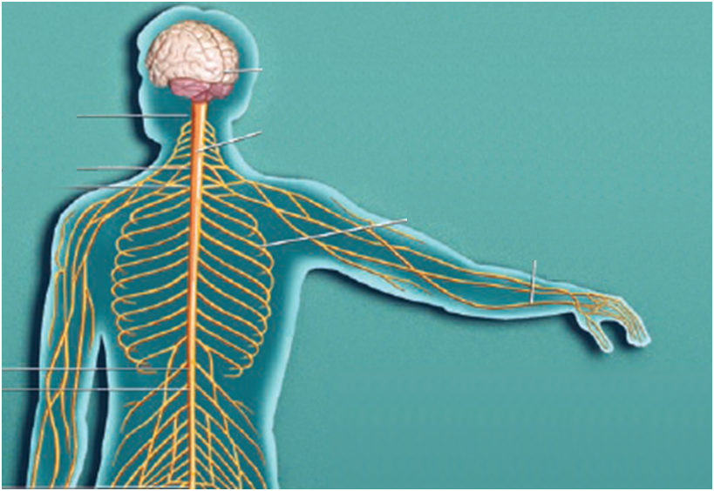
Flex your
bicep muscle!
Notes:
Telephone activity

Slide 20
Neuron Telephone
Make a line (in groups of 6-7)
The first student is a decision-making neuron in the brain that chooses an appropriate action.
Neurons only send messages across short distances and only in one direction. Each neuron must whisper it to the next neuron in line without asking for a repeat.
The last student, the “effector” (the muscle), performs the action.
The “effector” rotates to the front of the line and becomes the new decision-making neuron.
Rotate until each student gets to play each role.

Slide 21
Telephone Reflection Questions
How well did your group get each message clearly down the line? Did any messages get lost or changed before it reached the end of the line?
What would happen if a real neuron received the wrong message or didn’t receive the message at all?
What if that “message” that got lost wasn’t a muscle movement but instead, *I feel good today*

Slide 22
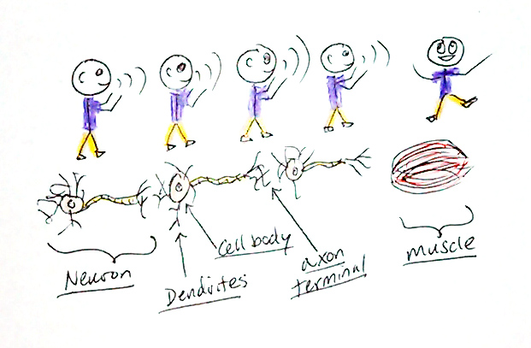
Neurotransmitters are chemicals sent from one neuron’s axon terminal to the next neuron’s dendrites.
Label the parts of the stick figures that represent the axon terminal, neurotransmitters, and dendrites.

Slide 23
Causes of mental disorders
Brain damage from injury, concussions, stroke, brain tumors (cancer), etc.
Traumatic experiences (e.g. death of a loved one)
Drug abuse
Heredity (higher risk of mental disorders if they run in the family)
“Chemical imbalance in the brain”
Therapy (1 on 1, or in a group)
Medication (e.g. antidepressants, antipsychotics)
Treatments of mental disorders

Slide 24
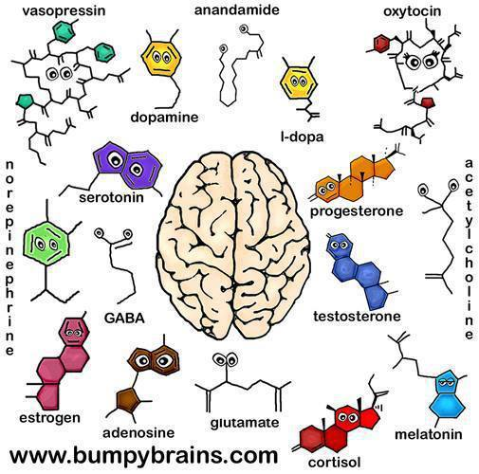

Slide 25
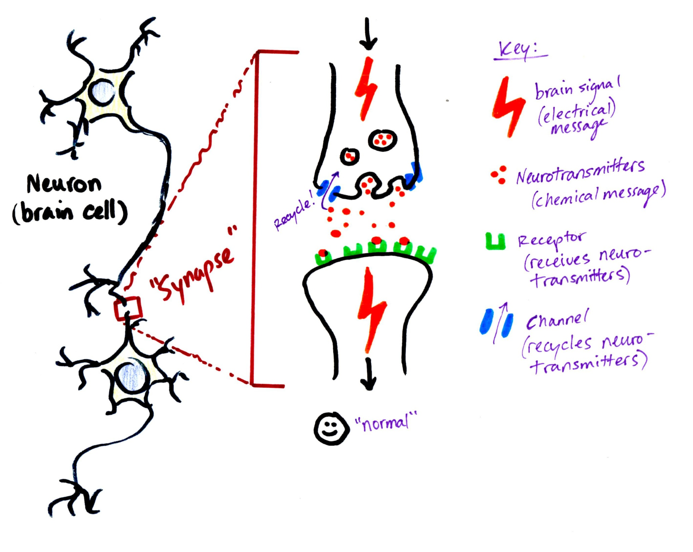
`

Slide 26
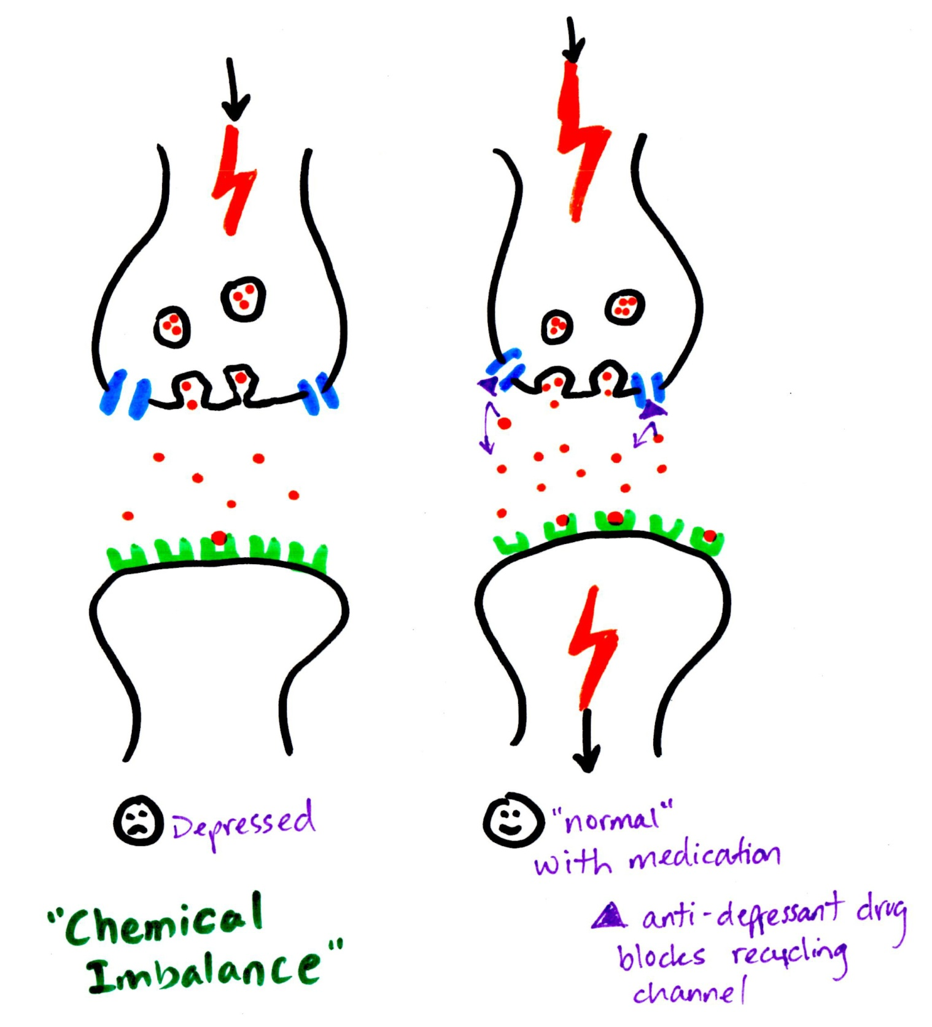
This neurotransmitter
is “Serotonin” →
Explain what is different
with Depression and
how the medication
solves the problem

Slide 27
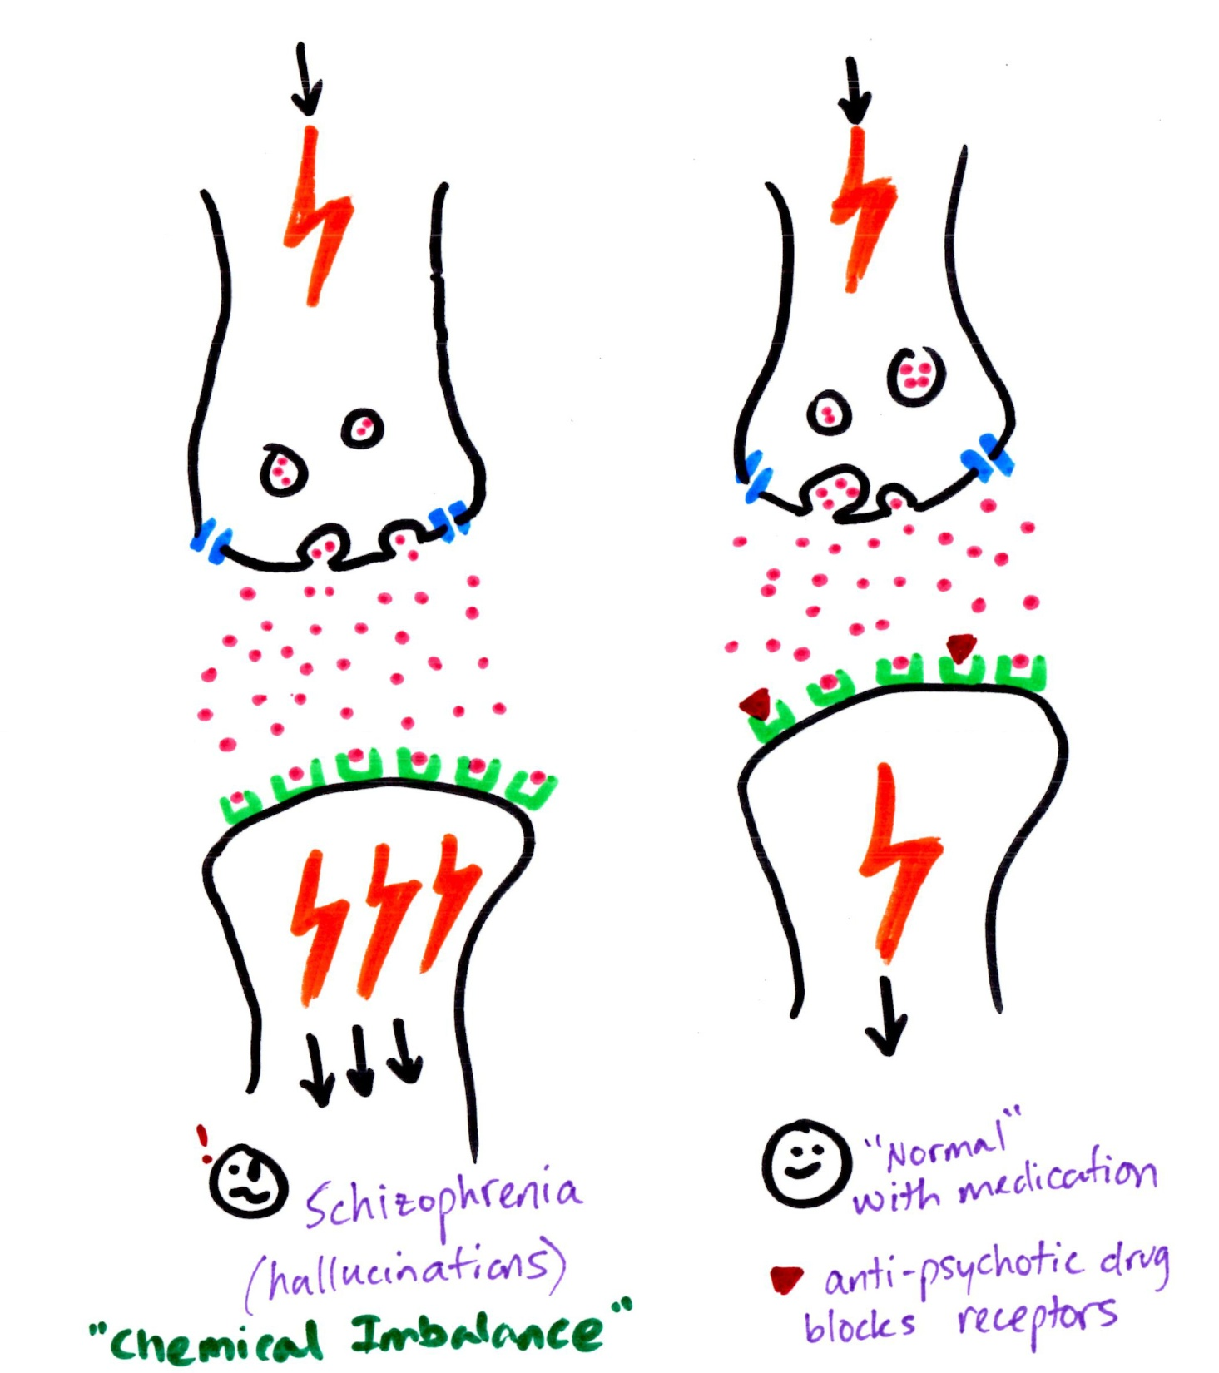
This neurotransmitter
is “Dopamine” →
Explain what is different
with schizophrenia and
how the medication
solves the problem

Slide 28
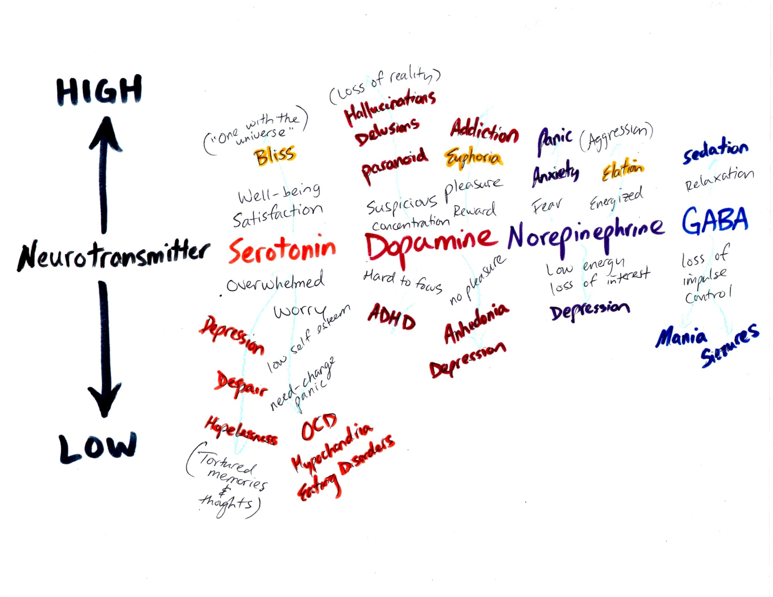

Slide 31
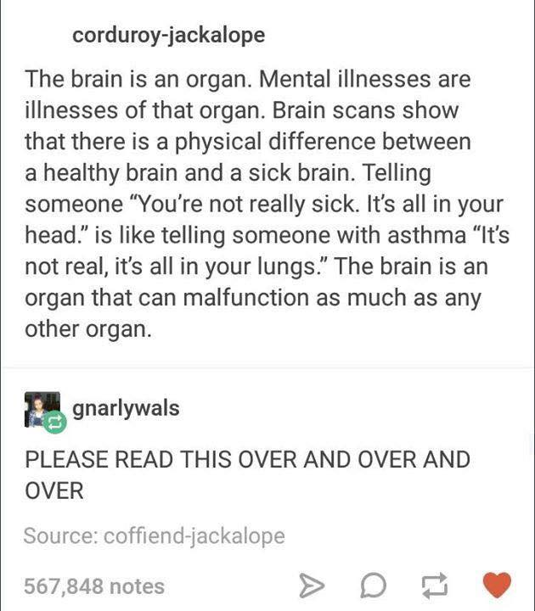

Slide 34
Identify and explain 3 pieces of evidence that demonstrate why mental illnesses should be viewed and treated the same way as physical illnesses.

