Slide 1
Causal Relationships
More studying
Better grades
Taking pain killers
Less pain
Increased spending on advertising
Higher sales
Notes:
Distributions that are single-peaked and symmetric with no outliers can be modeled with a bell curve. In later lessons we will learn how using a normal model helps us connect information about a sample to information about the whole population.

Slide 2
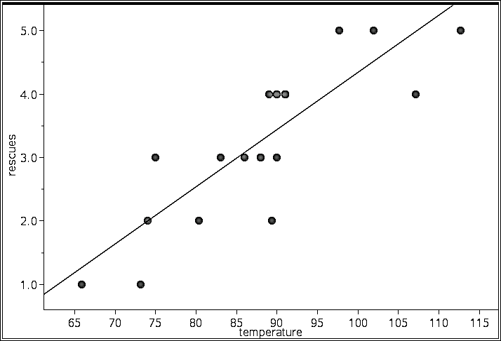
Beach Rescues vs. Temperature
Does warmer weather cause unsafe swimming?
r = 0.84
Probably not…

Slide 3
Linking Variable
↑ Swimming
↑ Beach
Rescues
↑ Temperatures

Slide 4
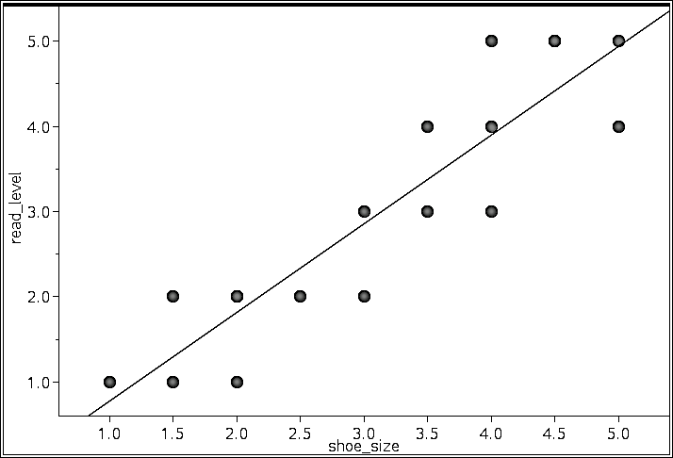
Reading Score vs. Shoe Size
r = 0.91
Bigger feet cause better reading??
Notes:
Distributions that are single-peaked and symmetric with no outliers can be modeled with a bell curve. In later lessons we will learn how using a normal model helps us connect information about a sample to information about the whole population.

Slide 5
Lurking Variable
↑ Age
↑ Shoe size
↑ Reading Score

Slide 6
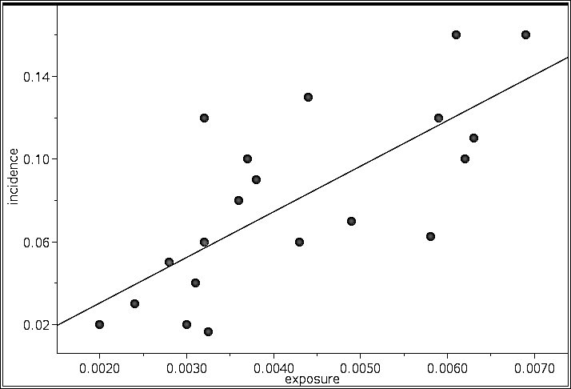
Incidence of Illness (%) vs. Exposure to Chemical (ppm)
r = 0.73
Does exposure cause illness?
Correlation doesn’t answer these questions!
Is a third variable involved?

Slide 7
Cheaper engagement ring = longer lasting marriage
Can I make my marriage last longer if I buy a cheaper ring?
Oatmeal and life expectancy
Blueberries and life expectancy

