Slide 1
Nutrition

Slide 2
6 Nutrients
Water
Vitamins
Minerals (“Dietary Elements”)
Carbohydrates
Fats (“Lipids”)
Proteins

Slide 3
6 Nutrients
7
Water
Vitamins
Minerals (“Dietary Elements”)
Carbohydrates
Fats (“Lipids”)
Proteins
Nucleic acids
(^ the health textbook forgot this one)

Slide 4
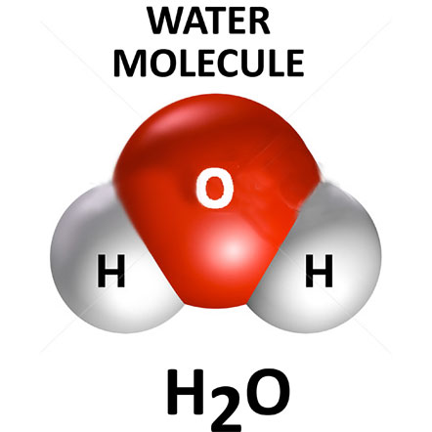
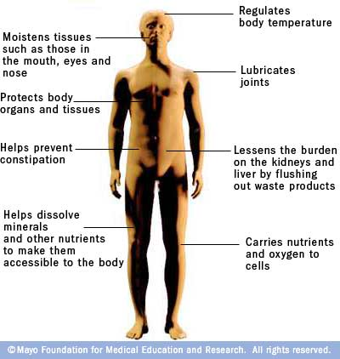
Structure & Functions of Water
Structure: Small molecule (1 oxygen, 2 hydrogen)→
Functions:

Slide 5
Water (continued…)
1) Why does the body need water? p. 166 2) How does the body lose water? p. 165 3) How much water does the textbook say we need to drink each day? (note: your textbook is wrong) 4) What affects the amount of water we need to drink each day? (Explain why your textbook is wrong) 5) What is hyponatremia? What are the symptoms? 6) What are the symptoms of dehydration? p. 166 7) What is homeostasis? (bio textbook ch 28.2) 8) How do dehydration and hyponatremia relate to homeostasis?

Slide 6
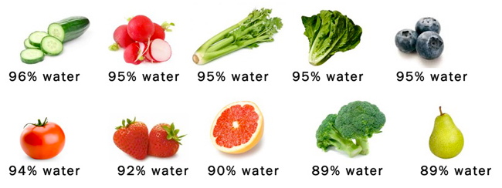
Dietary Sources of Water
Sources: Drinks, soups, most fruits & vegetables
N-1: Check off the water column for all of the fruits, vegetables, drinks, and soups on your N-1 grid paper

Slide 7
Vitamins and Minerals
Structures and functions of vitamins
Structures and functions of minerals
Write down the functions of 3 example vitamins (e.g. vitamins A, B, and C) and 3 minerals (e.g. Sodium, Calcium, Potassium)
N-1: mark the foods that have each vitamin/mineral

Slide 9
Structure: 13 complex “organic” molecules
(made of carbon, hydrogen, and oxygen)
Functions & Sources:
see health textbook (pg. 161-162)

Slide 10
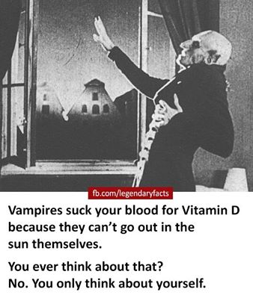

Slide 11
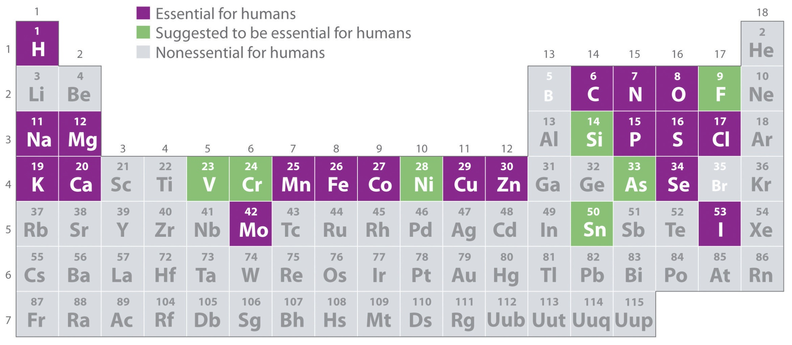
Minerals
Structure: 20+ different elements
Function & Sources: see health textbook (pg. 163)

Slide 12
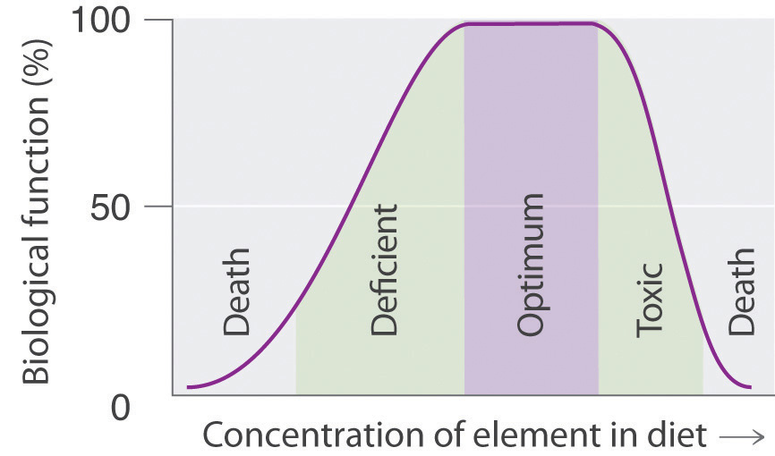
The Dose Makes The Poison

