Slide 1
The Dose Makes the Poison

Slide 2
name, date, period, title = “Water”
Claim: How much water would you have to drink in a short period of time for it to kill you?
Evidence: Use at least 3 examples from stories
Reasoning: Since the stories are about different people with different ages and volumes, explain how you came to your answer.
Conversions (approximations)
1 Gallon ≈ 4 Liters 8 cups ≈ ½ Gallon
1 Liter ≈ 1 Quart
End

Slide 3
“The dose makes the poison”

Slide 5
What does this mean?

Slide 6
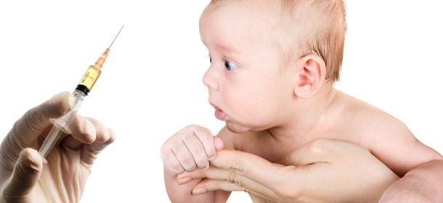
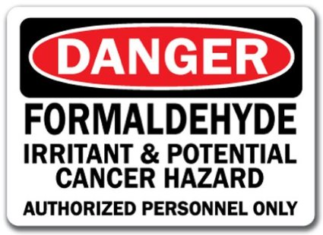
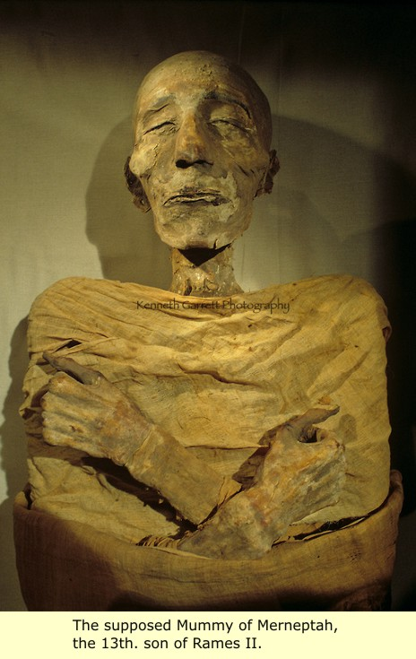
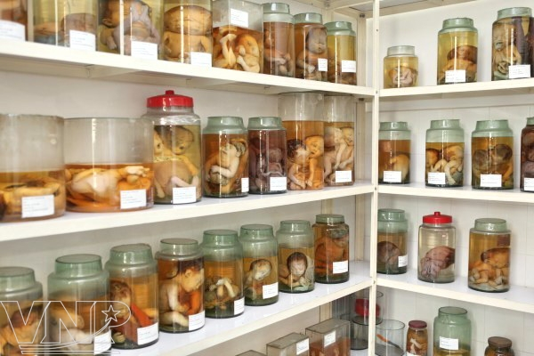

Slide 8
Explain this to a 10 year old, and give an example

Slide 9
Water (continued…)
1) Why does the body need water? p. 166 2) How does the body lose water? p. 165 3) How much water does the textbook say we need to drink each day? (note: your textbook is wrong) 4) What affects the amount of water we need to drink each day? (Explain why your textbook is wrong) 5) What is hyponatremia? What are the symptoms? 6) What are the symptoms of dehydration? p. 166 7) What is homeostasis? (bio textbook ch 28.2) 8) How do dehydration and hyponatremia relate to homeostasis?

Slide 10
How to count stamps
In pairs, out loud, together
One binder at a time
Start from the beginning of this semester
Include journal/calendar stamps if Warren is the advisor for the Exercise project
Ignore things in pen (stars are not stamps)
Write full name, period, and number of stamps on the scrap paper
End

