Slide 1
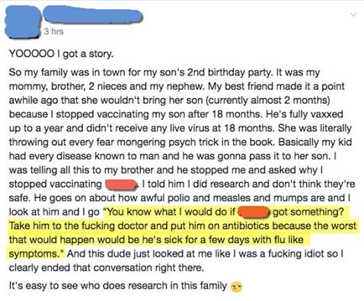
1. What are vaccines, what do they do, how do they work, and why should we use them?
https://www.youtube.com/watch?v=rb7TVW77ZCs
https://www.youtube.com/watch?v=zQGOcOUBi6s
https://www.youtube.com/watch?v=y0opgc1WoS4

Slide 3
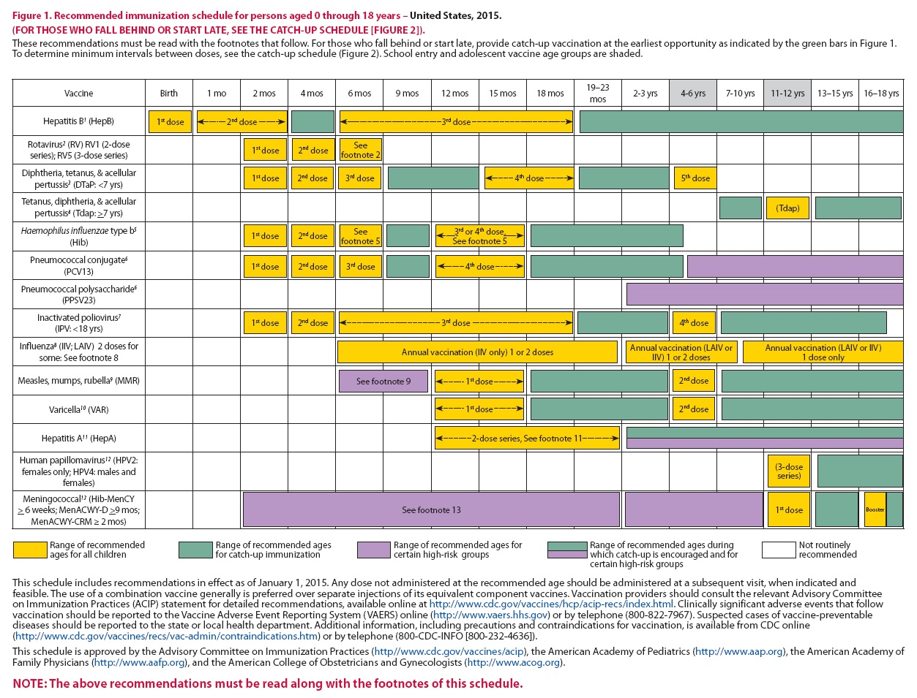

Slide 5
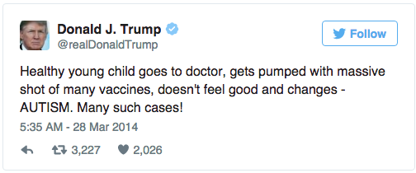
2. Why does Jenny McCarthy think vaccines cause autism? What science literacy mistake is she making?
https://www.youtube.com/watch?v=qGW4a96GqGc
https://www.youtube.com/watch?v=o65l1YAVaYc
3. What scientific evidence has there been about vaccines and autism?

Slide 8
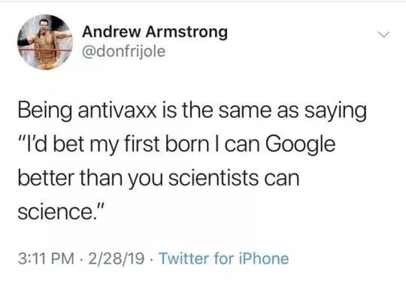
4. Free-write your opinions, thoughts, and questions related to the anti-vaccination movement spurred on by passionate parents like Jenny McCarthy.
https://www.youtube.com/watch?v=k00anSFA4-Y
https://www.youtube.com/watch?v=QgpfNScEd3M
https://www.youtube.com/watch?v=LWCsEWo0Gks

Slide 9
5. Explain “herd immunity”, what it requires for it to work, who it protects. https://www.youtube.com/watch?v=ZuiHFg_nfnE https://www.youtube.com/watch?v=7VG_s2PCH_c

Slide 12
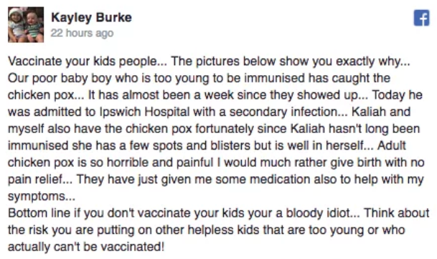
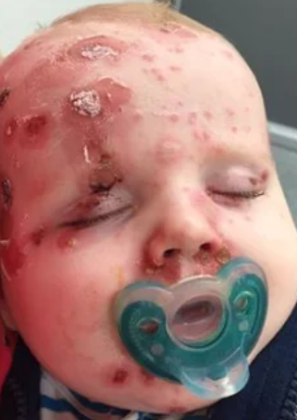
6. Compare the risks of a vaccine harming you vs. the risks of NOT getting vaccinated
https://www.youtube.com/watch?v=NaGndICPT8I

Slide 13
Victims of their own success https://www.youtube.com/watch?v=3aNhzLUL2ys

Slide 15
7. Evidence Base Writing –1 paragraph
Decide who has the right to make the decision for a child to be vaccinated—the parents or the government.
If you value freedom to choose more than security, explain why. Then, decide which outcome you think is best (see below), and finally explain why parents should still choose to vaccinate even if they’re scared to.
Allow outbreaks to occur and people to get sick and possibly die
People who are too young/old or allergic to vaccines should avoid public places where they are at risk (school, Disneyland, etc.)
Kids whose parents don’t want to vaccinate them shouldn’t be allowed in public places (school, Disneyland, etc.)
If you value security over freedom, provide a strong argument for why everyone needs to get vaccinated despite the risks

Slide 17
Why are there dangerous chemicals in vaccines?
https://www.youtube.com/watch?v=ztkNLWFgYH8

Slide 19
Debunking anti-vaxxers: https://www.youtube.com/watch?v=b03U6BYF9L0
Copy or paraphrase the anti-vaxx argument, then counter it using science literacy concepts
8. Vaccinations have harmful chemicals in them (formaldehyde causes cancer!).
9. Jenny McCarthy and thousands of other parents share their personal experiences about how their children were vaccinated and then developed autism.
10. There’s a correlation between vaccines and autism (vaccine use and diagnosis of autism have both increased over the last 20 years).
11. Vaccines aren’t natural. We can rely on our natural immunity.
(Counter these arguments, but science literacy concepts won’t apply to these)
12. A science article in 1998 said that vaccines caused autism.
13. Vaccines aren’t necessary because viruses we vaccinate for aren’t around anymore!
14. Vaccines can cause dangerous side effects (such as rare but harmful allergic reactions).
15. Vaccines aren’t necessary. Pharmaceutical companies are just trying to make money.

